Slide 1
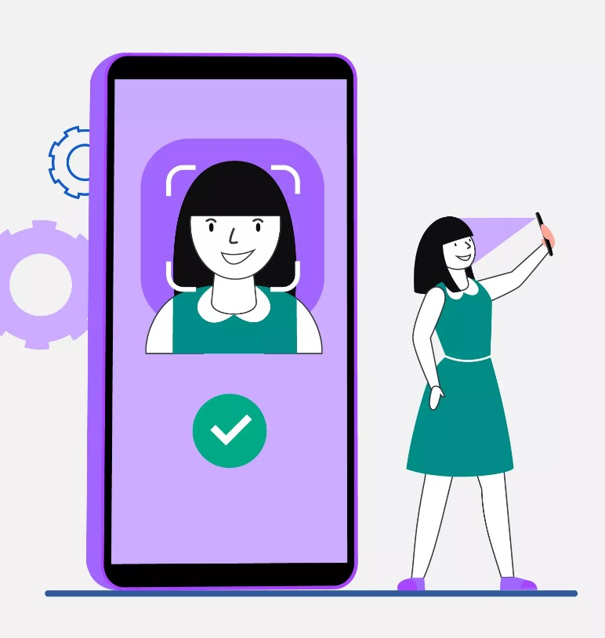
FACE RECOGNITION ATTENDANCE

Slide 2
CONTENTS
ABSTRACT
EXISTING SYSTEM
PROPOSED SYSTEM
HARDWARE & SOFTWARE SPECIFICATION
SYSTEM DESIGN
MODULES
CONCLUSION
FUTURE ENHANCEMENT

Slide 3
ABSTRACT
Face recognition is the task of identifying an already detected object as a known or unknown face.
Often the problem of face recognition is confused with the problem of face detection.
Face Recognition is to decide if the "face" is someone known or unknown using stored databases.

Slide 4
EXISTING SYSTEM
Previously attendance was noted in excel sheet
It needs human time.
Human error is possible here in manual entry

Slide 5
PROPOSED SYSTEM
The task of the proposed system is to capture the face of each student and to mark their attendance.
The face of the student needs to be captured in such a manner that all the feature of the student’s face needs to be detected.
There is no need for the teacher to manually take attendance in the class because the system captures the image and through further processing steps the face is being recognized.

Slide 6
SYSTEM SPECIFICATION
Hardware Specification:
Processor : Any Core Processor
Hard Disk : 512 GB or Higher
RAM : 4 GB or Higher
Software Specification:
Operating System : Windows 7 or Higher
Language : Python (OpenCV)

Slide 7
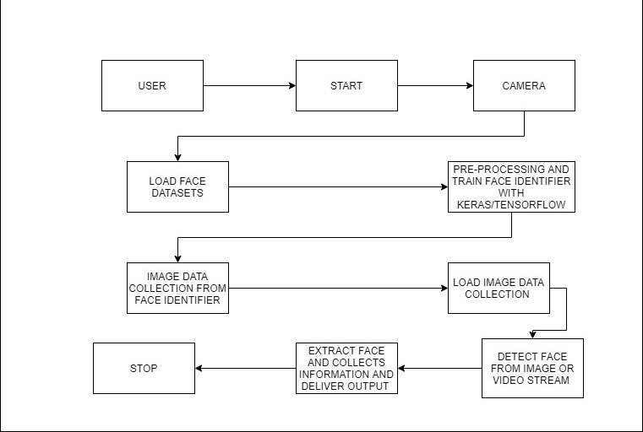
SYSTEM DESIGN

Slide 8
MODULES
Login Module
Data Collection
Model Training
Image Predictions

Slide 9
Login Module:
In this module, the faculty login is performed. The faculty can login into the attendance management system with the help of username and password.
By using login module the faculty can access student’s attendance from autogenerated Excel sheet.

Slide 10
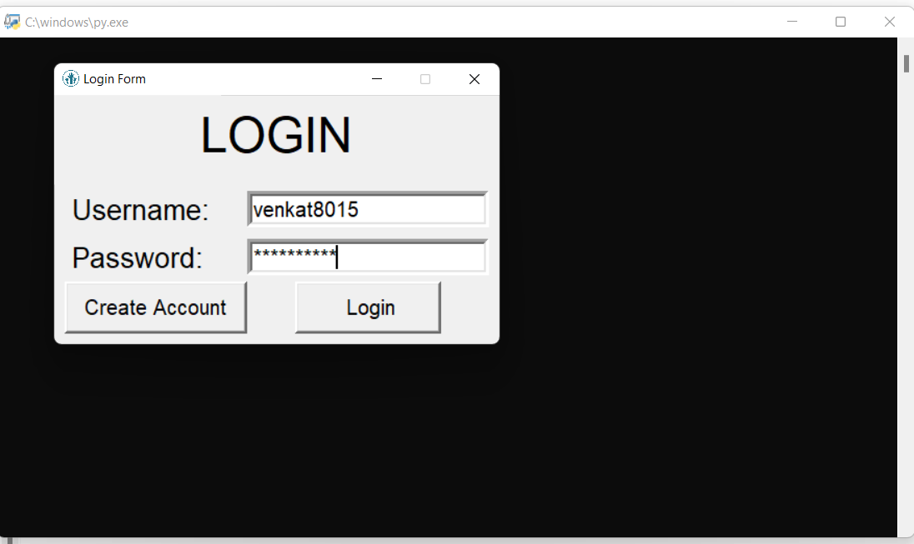
Login Module:

Slide 11
Image Data Collection:
In this module, we are going to collect the images which are needed to train and test the model we are going to use. We can collect the images of the person wearing mask through the take images function which will be stored in a folder and can be used for tracking process.

Slide 12
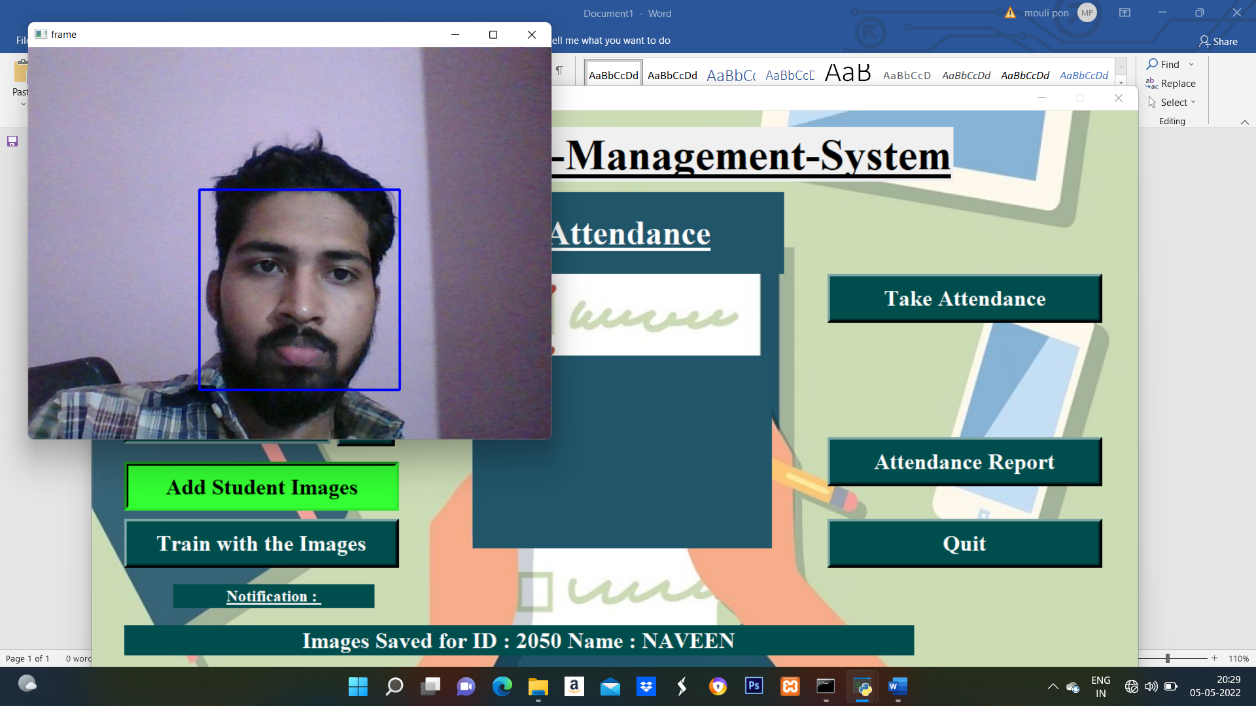
Image Data Collection:

Slide 13
Model Training:
Now, the classified images are given as input to the models which are used to train the machine to detect whether the person wearing mask or not.

Slide 14
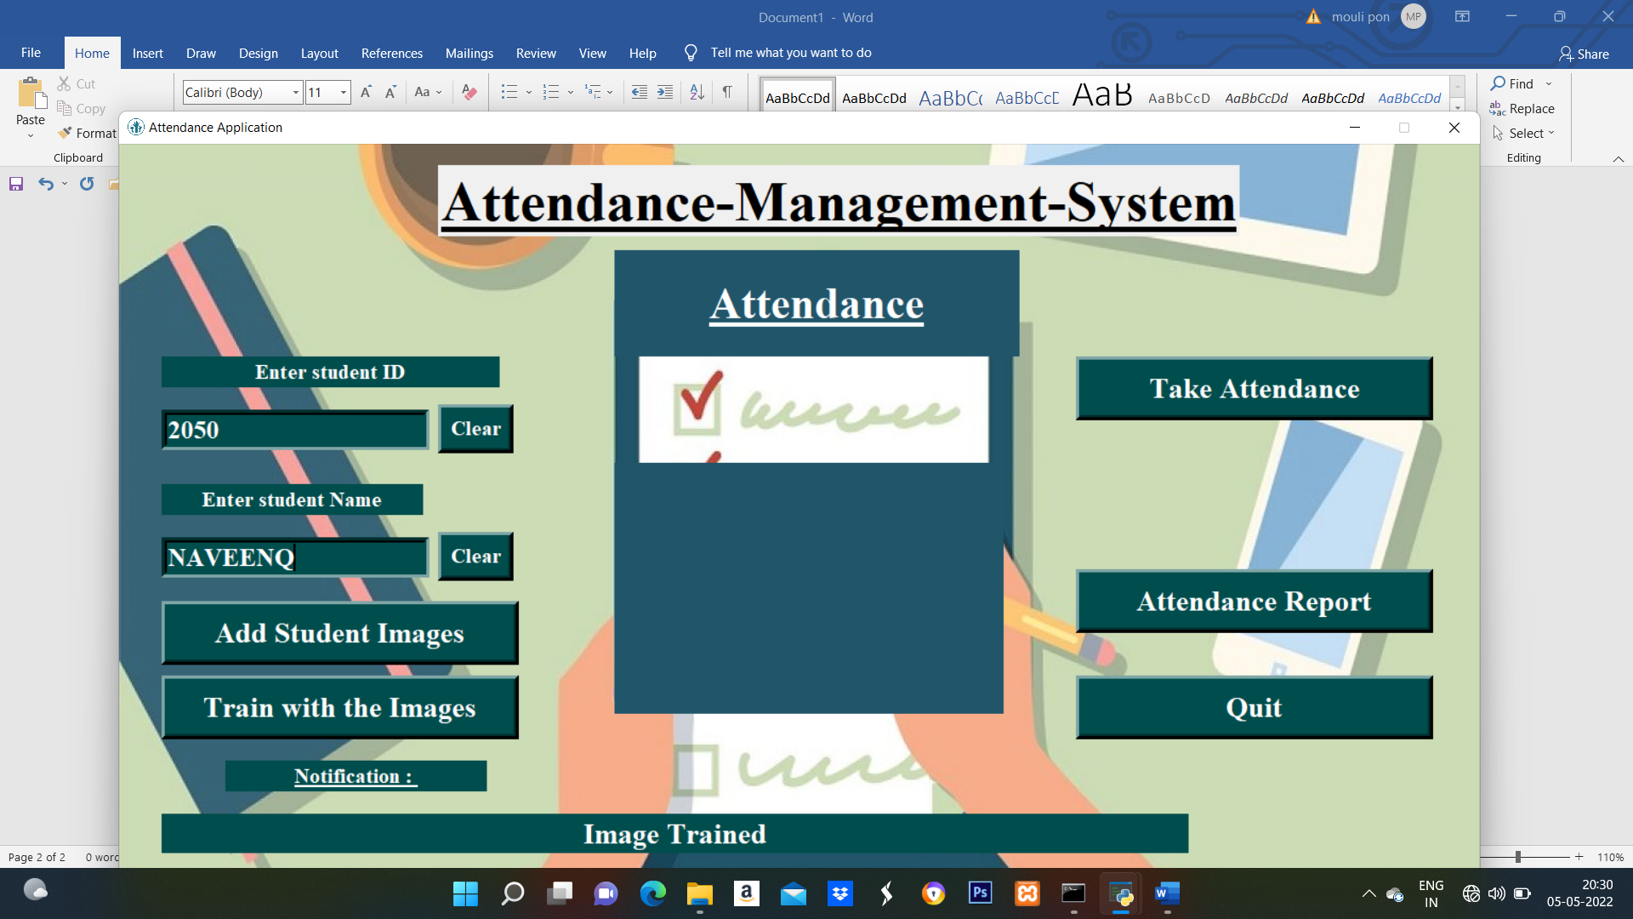
Model Training:

Slide 15
Image Predictions:
Only the authorized person's details will be displayed and when an unauthorized person is detected by the camera it sends an e-mail to the concerned e-mail address. Now, the machine can able to detect and send the e-mail.

Slide 16
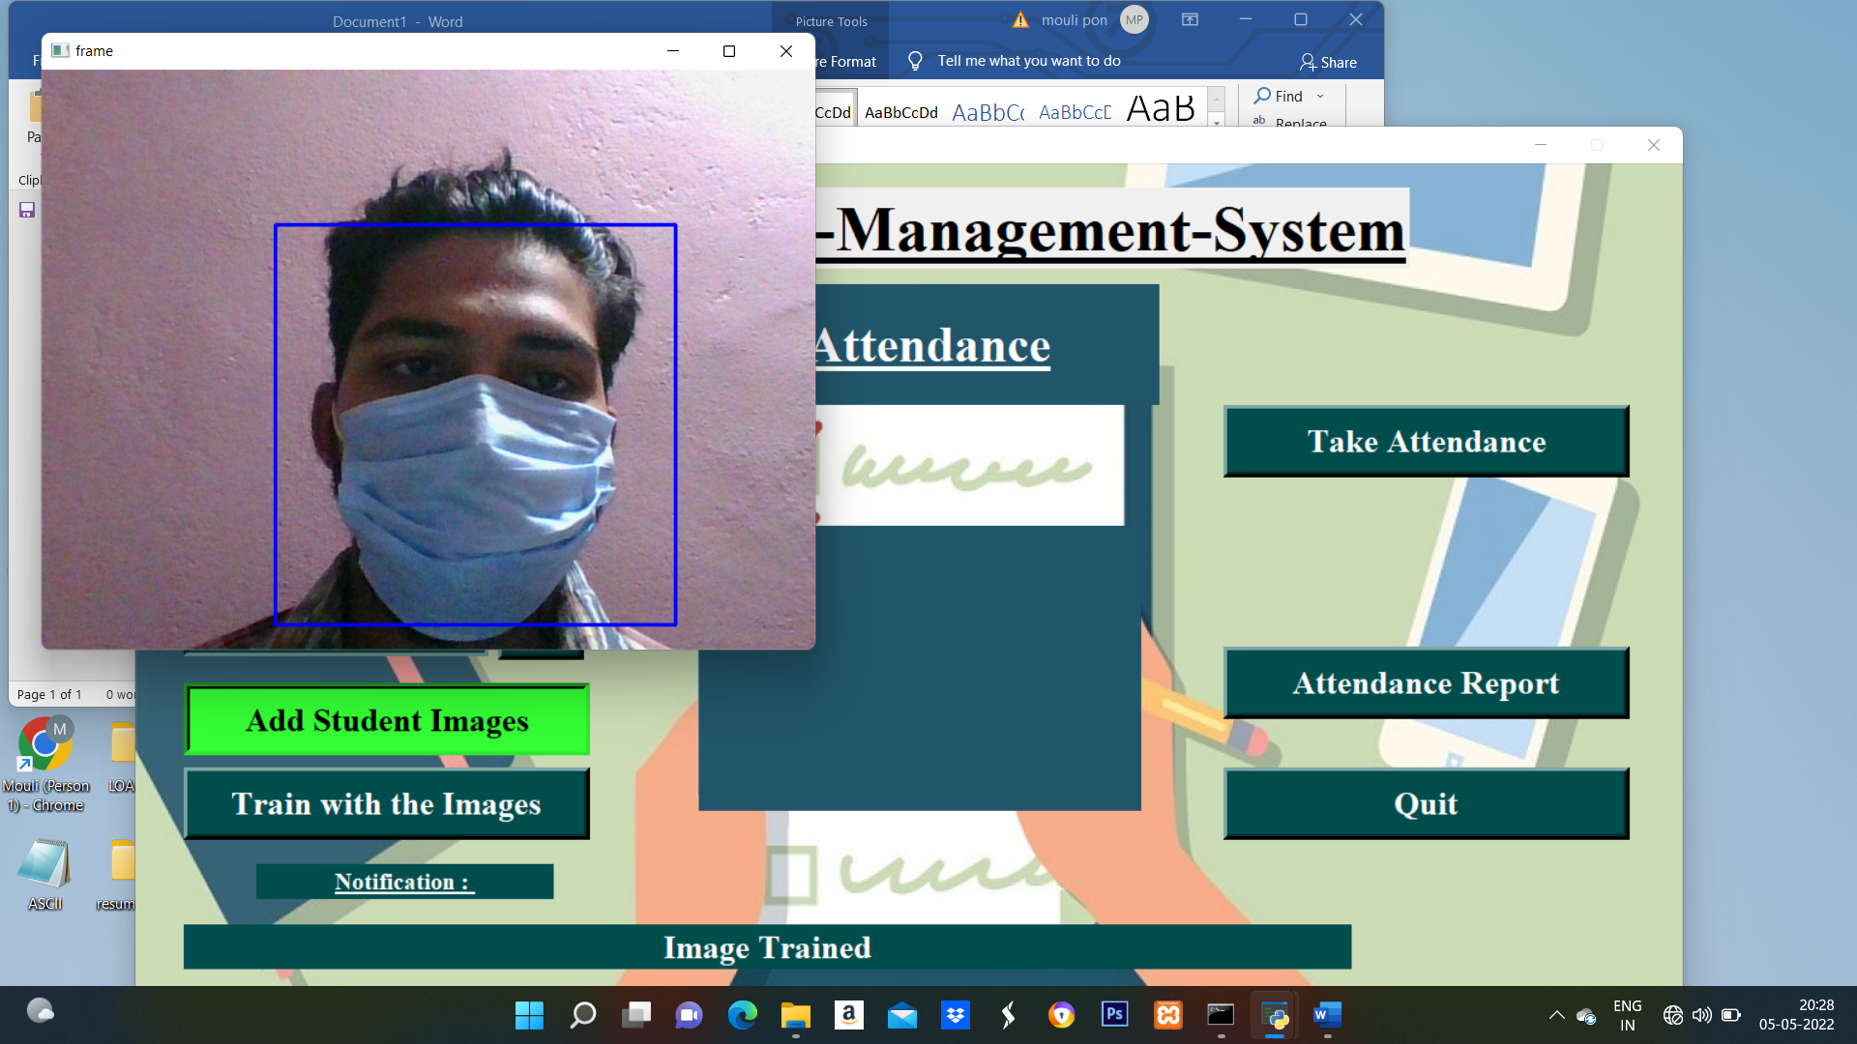
Image Prediction:

Slide 17
CONCLUSION
We have modelled a face identifier in neural networks. To train, validate and test the model, we used the dataset that consisted of faces images.
These images were taken from various resources like Kaggle and RMFD datasets.
The model was inferred on images and live video streams. To select a base model, we evaluated the metrics like accuracy, precision and recall and selected architecture with the best performance having 100% precision and 99% recall.
This face identifier can be deployed in many areas like shopping malls, airports and other heavy traffic places to monitor the public and to avoid the crime.

Slide 18
FUTURE ENHANCEMENT
The future scope of the proposed work can be using any cloud technology to store these images.
The system can be configured and used in ATM machines to detect frauds.

Slide 19
THANK YOU

